Slide 1
Making Art That Matters
Engaging Students in Issues of Social Justice
Stephanie Wirt & Stephanie Pickens

Slide 2
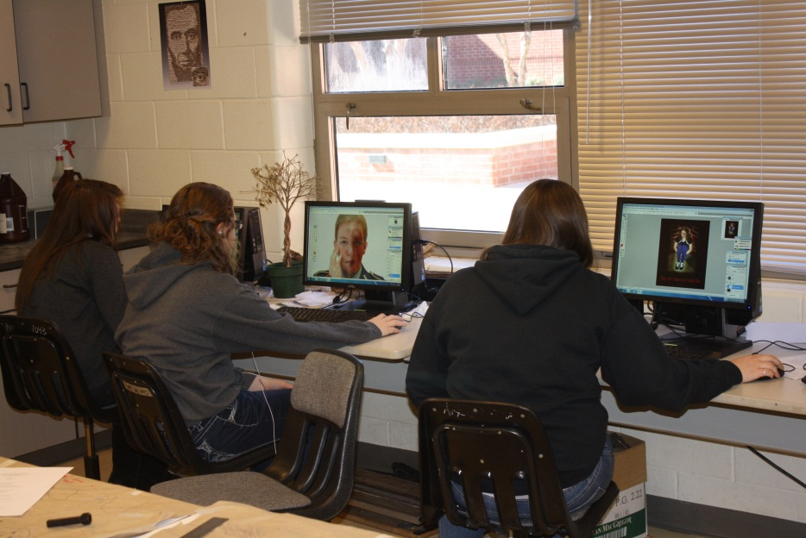
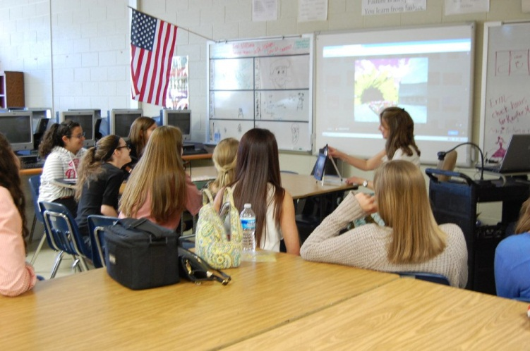
Same Project – 2 Approaches
PHS
Photo 1 Class
Digital Photography/Photoshop
iPads, Camera, Computer, Internet
FHS
Art Class
Traditional Media

Slide 3
Creating Art to Inspire and Address Issues of Social Justice
WFHS Student Art
PHS Student Art

Slide 4
Planning and Presentation

Slide 5
What is Social Justice?
Class Discussion + Local and Internet Research

Slide 6
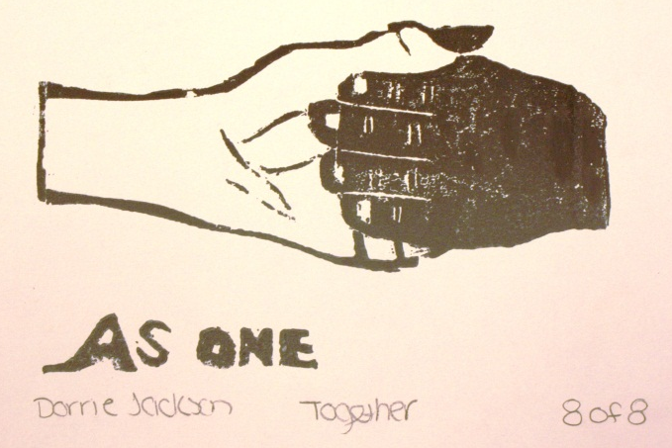
What matters in the lives of teenagers?
Body Image and Self Worth
Judgment of peers and strangers
Testing & Academic Pressures
Discrimination
Bullying
Depression and Thoughts of Suicide
Drug Abuse
Environmental Deterioration
War

Slide 7
Local and Global Research
Students mined the school to find examples of motivational and inspirational posters that are often exhibited in a school setting.

Slide 8
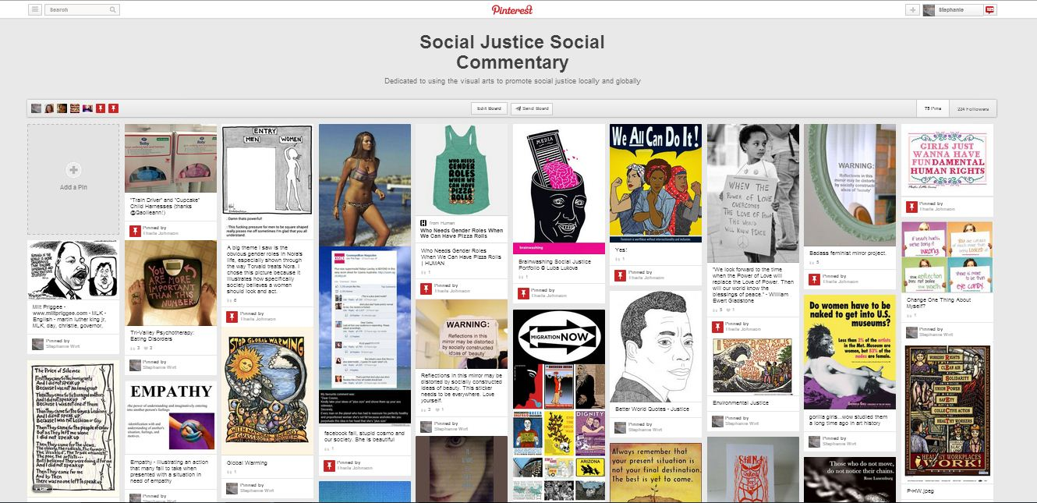
Collaboration and Documentation

Slide 9
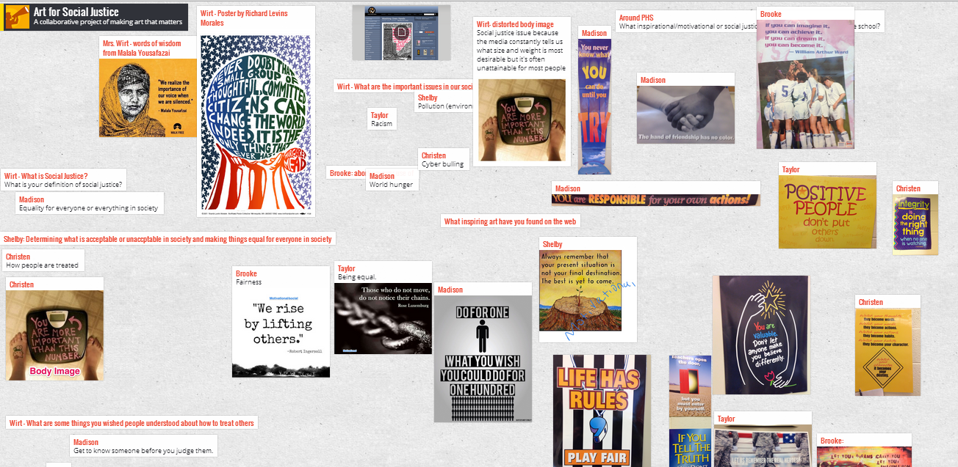
Collaboration and Documentation
Padlet – FREE online Bulletin Board used for easy collaboration

Slide 10
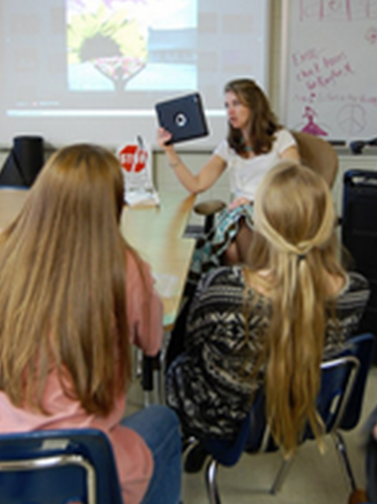
Sharing and Critiquing
Skype + Face Time
Shared Drop Box Folder

Slide 11
Student Art Creations
PHS
Student Series
on
Suicide Prevention

Slide 12
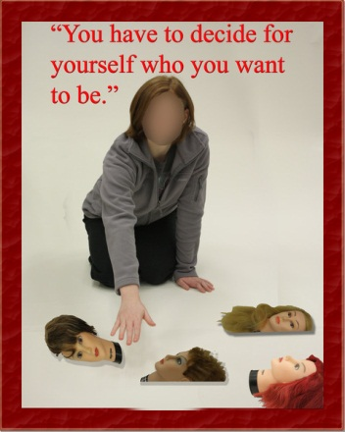
Student Art Creations
WFHS Student - Collage
WPHS Student – Digital Media

Slide 13
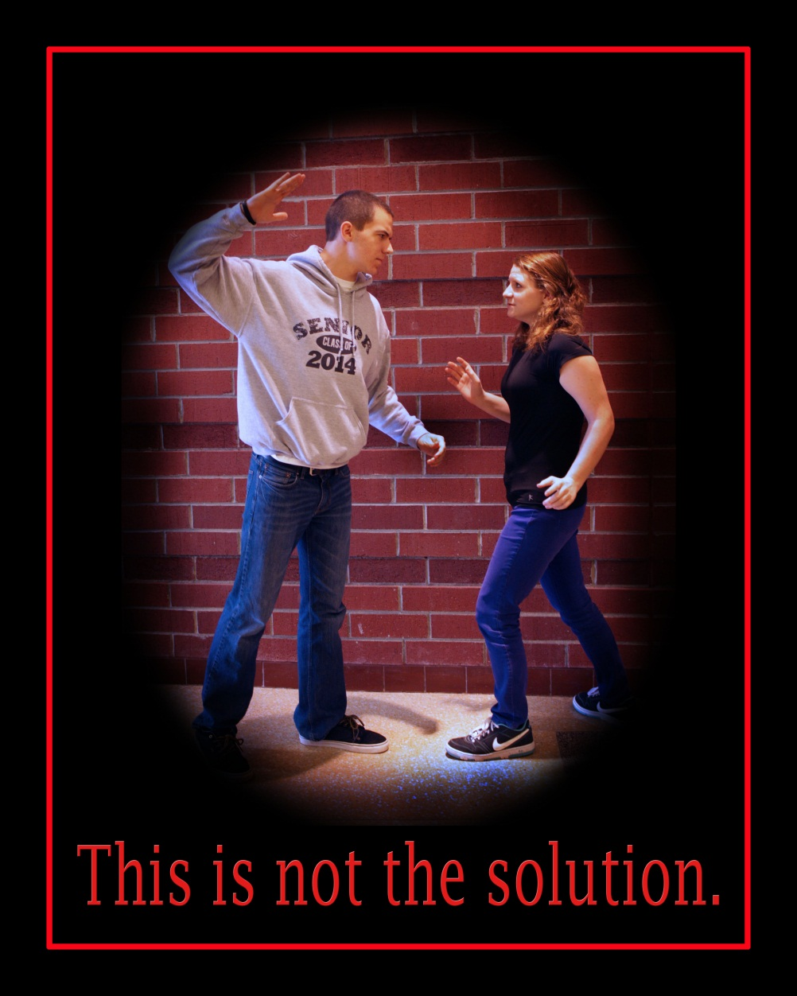
Student Art Creations

Slide 14
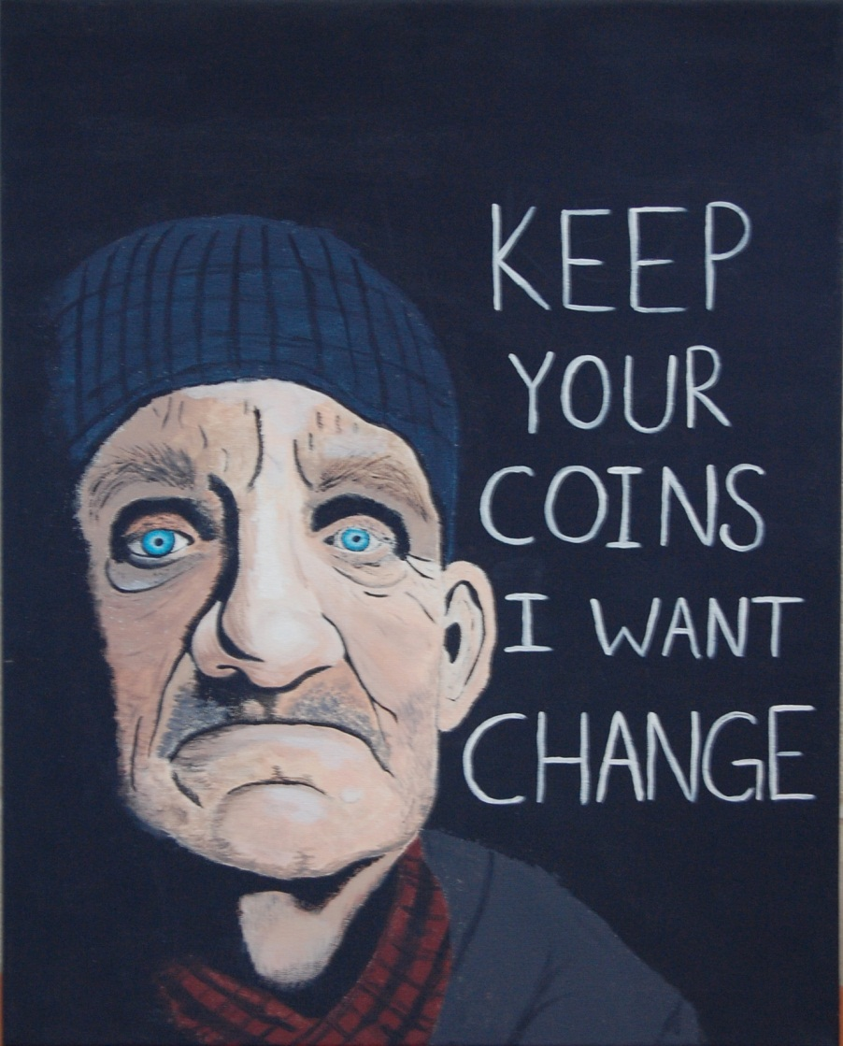
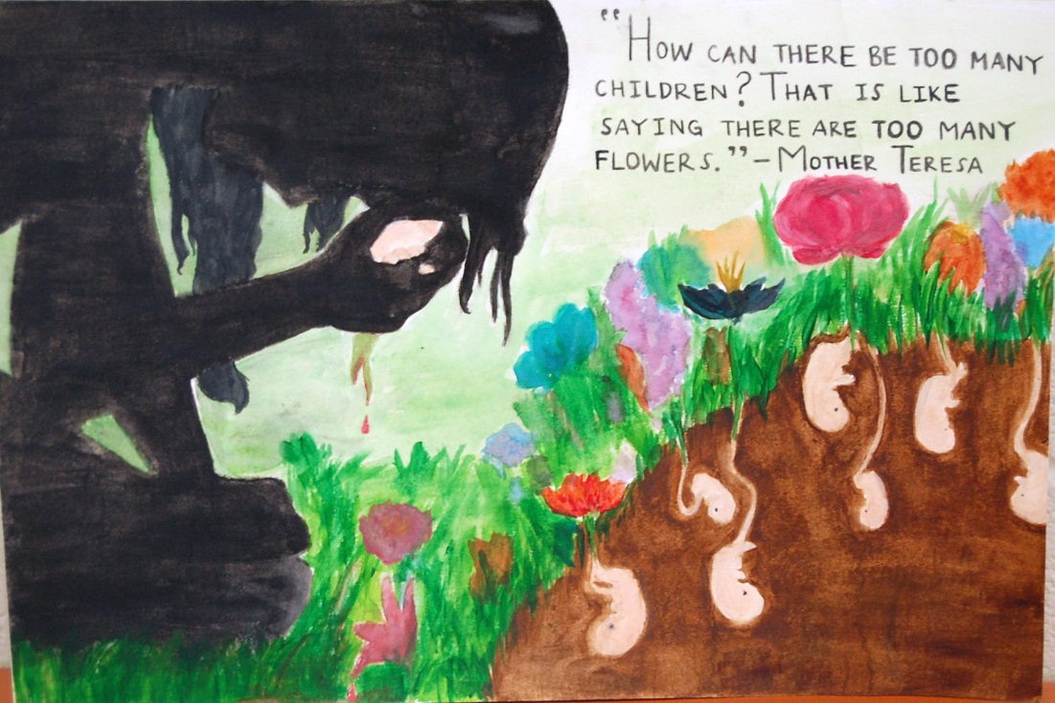
Student Art Creations
WFHS Student - Collage

Slide 15
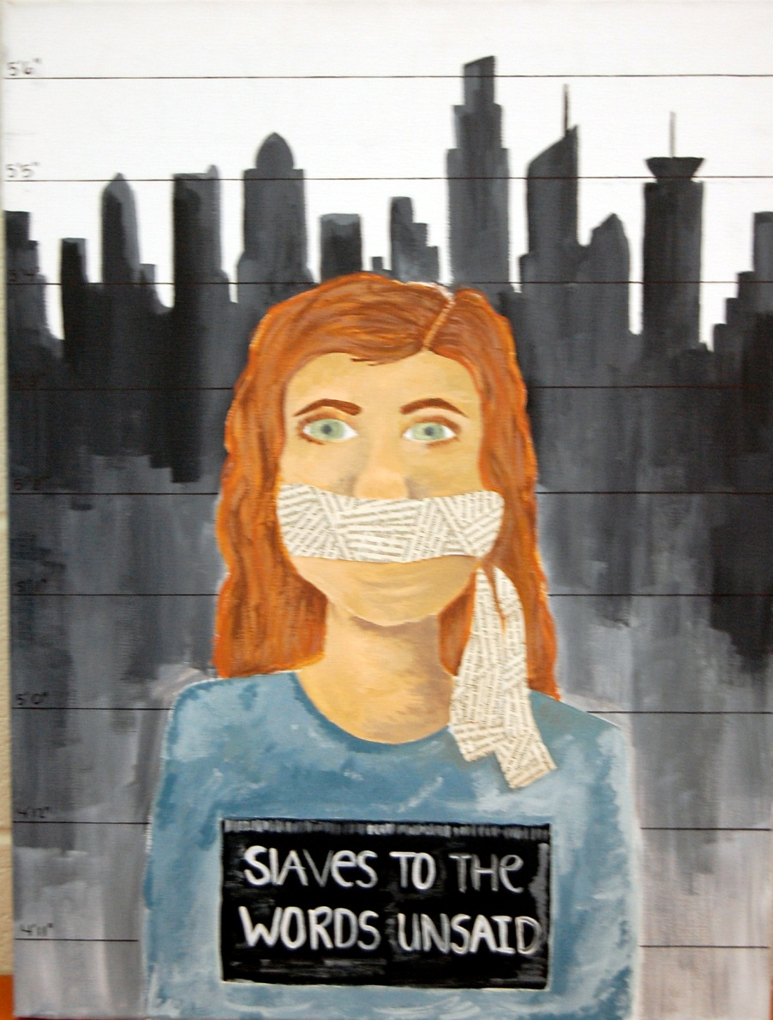
Student Art Creations
WFHS Student - Collage

Slide 17
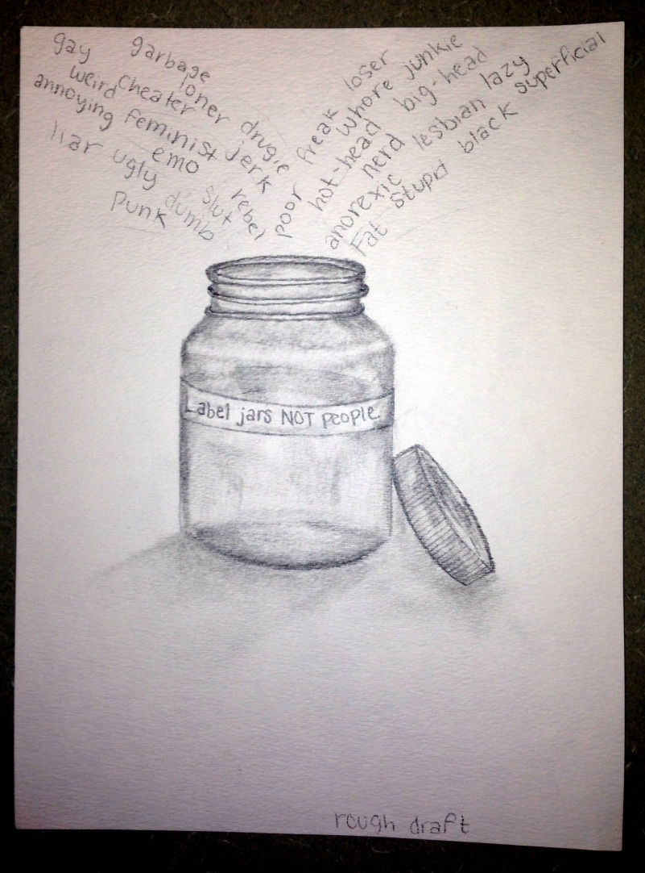
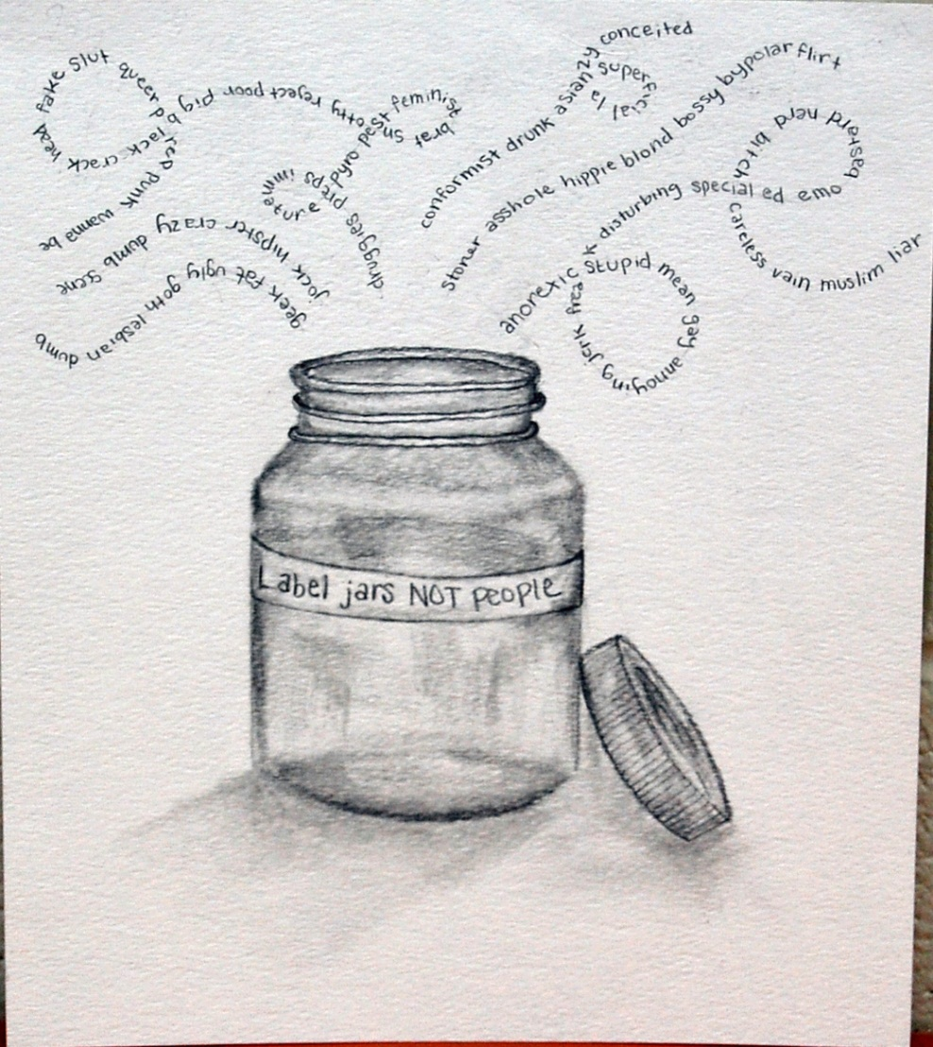
Student Art Creations
WFHS Student - Collage

Slide 18
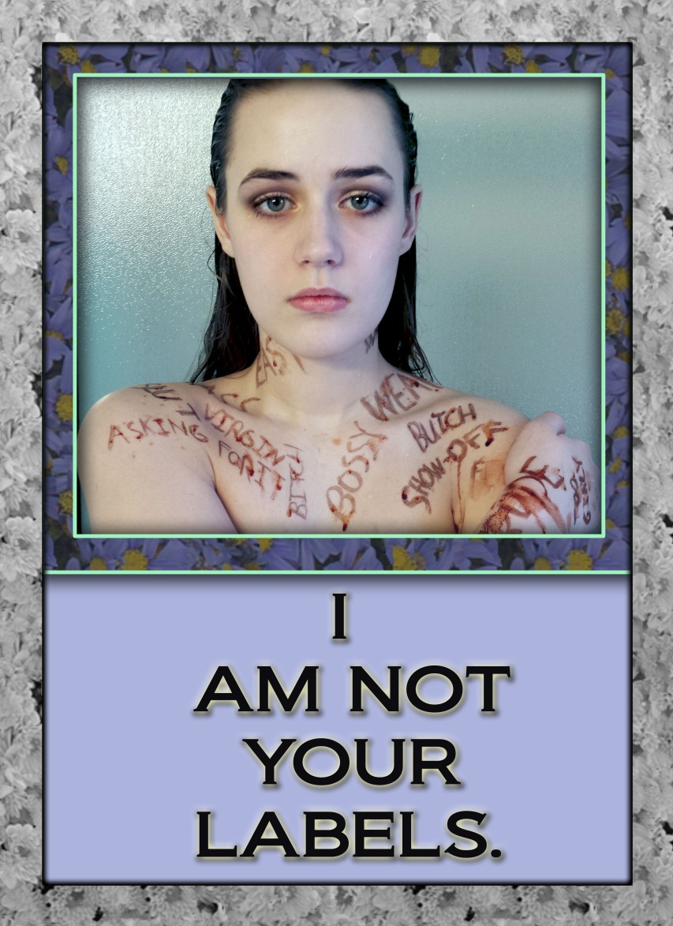
Student Art Creations

Slide 19
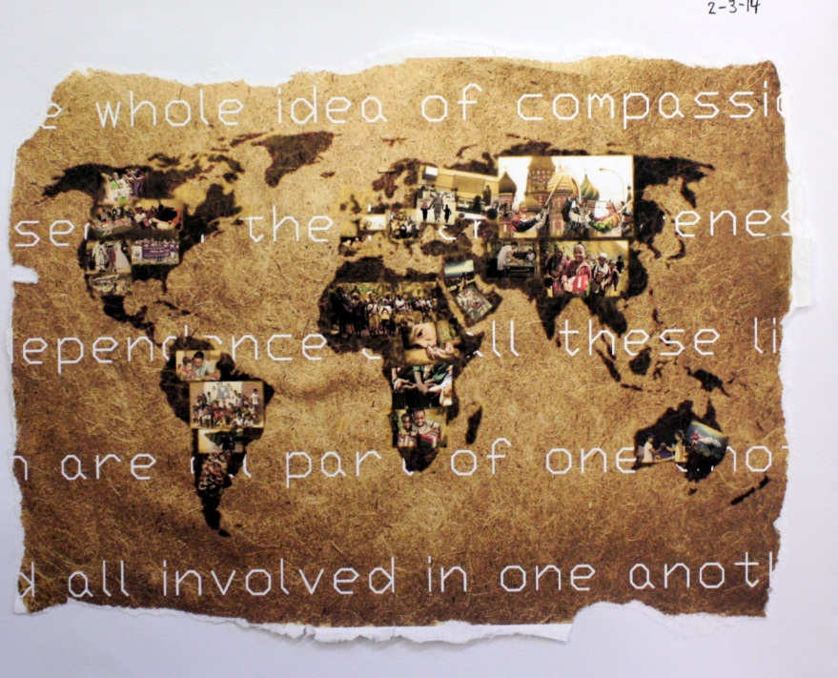
It Doesn’t Have To Be A “Single” Project
Social Justice in the Daily Viewpoint
Building Creative Thinking & Problem Solving Skills
“Society needs both justice and compassion, a head and a heart, if it is to be civilized.” -Julian Baggini
Compassion

Slide 20
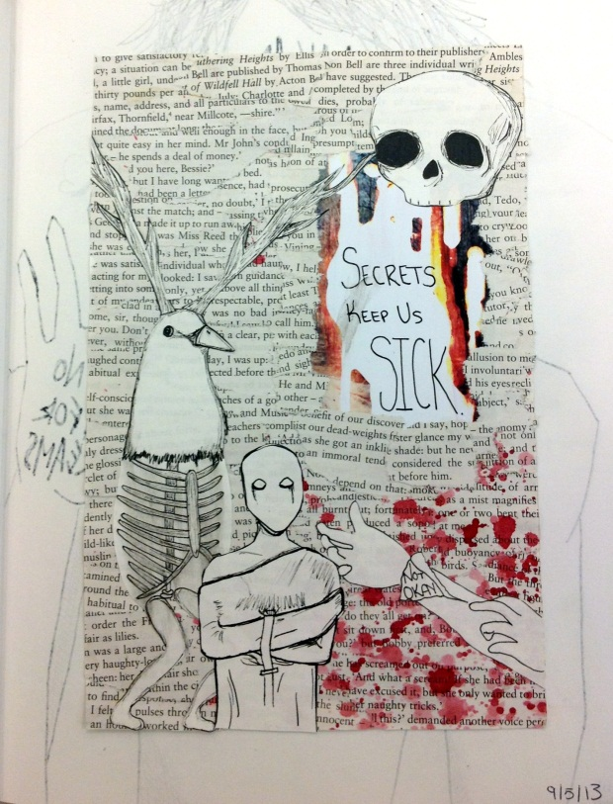
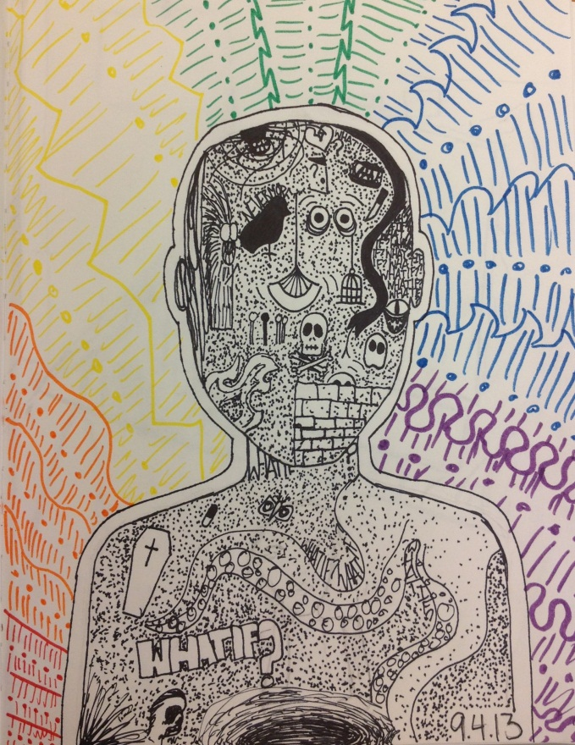
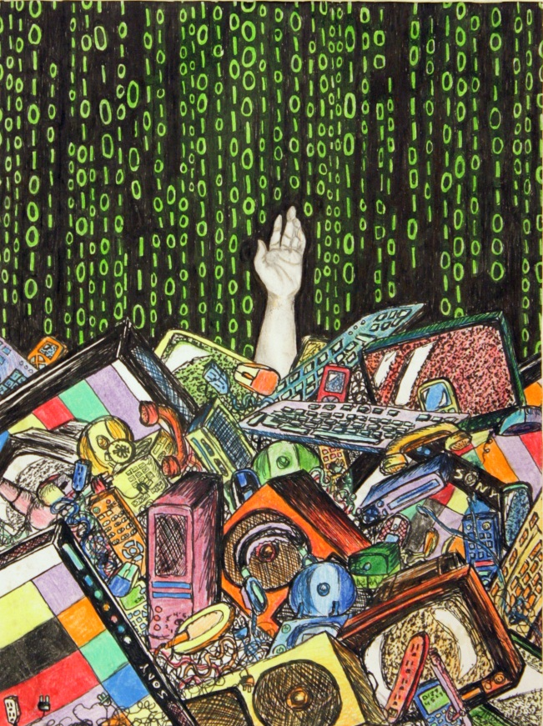
It Doesn’t Have To Be A “Single” Project
PHS Student Journal Pages

Slide 21
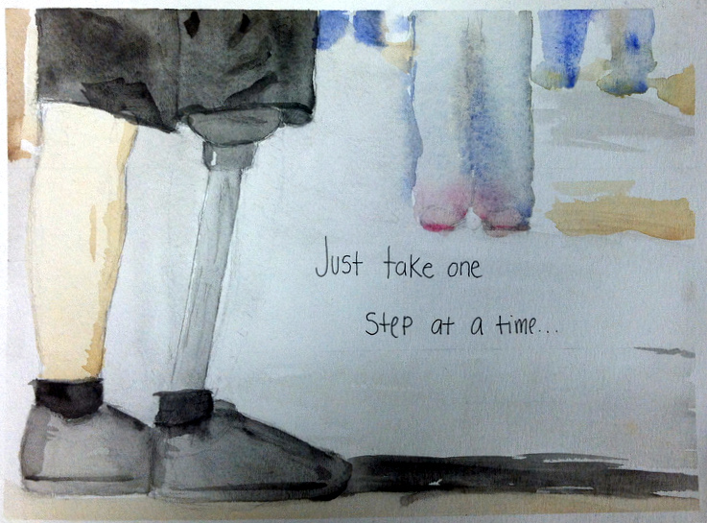
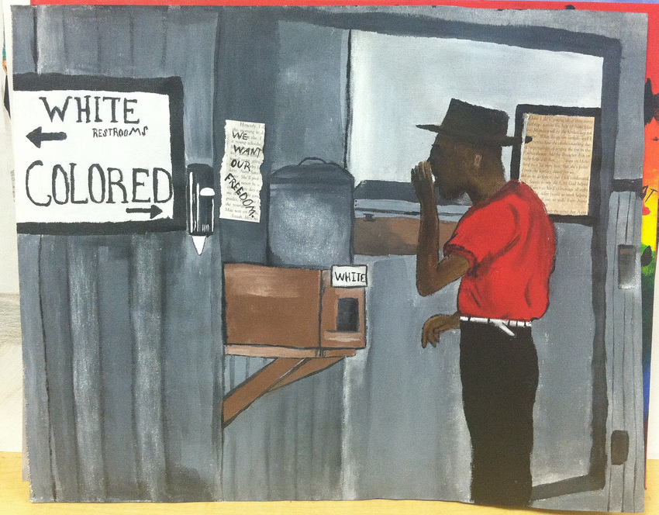
It Doesn’t Have To Be A “Single” Project
WFHS Student Work

Slide 22
Use it, Adapt it, Make it Yours
Find the entire unit plan, planning guides, rubrics, classroom power point presentations and useful links on our websites
Stephanie@wirtarttalk.org
www.stephaniepickens.com

